Slide 1
Set it and Forget it!
Matthew von Arx
Notes:
I’m Matthew von Arx
Presenting Set it and Forget It

Slide 2
Congratulations!!!
Notes:
Congratulations

Slide 3
So You Inherited…
>400k LOC, ~60 Project Codebase with CMAKE
Existing Bug Tracking System (Redmine)
1 Developer, >10 Years
No Consistent Practices
No Branch Organization
No Deployment Strategy
Notes:
So you’ve inherited
A 400,000 Line Codebase representing about 40 individually compiled, CMAKE based projects
• But there’s good news!, you have an existing bug tracking system in RedMine
• However, the software has been managed a single contract developer over the past 10 years
• And he didn’t use any consistent practices
• Or organize his SVN branches
• And definitely didn’t have a deployment strategy
But don’t worry…

Slide 4
Time for a Release!
Notes:
Its Time for a Release!

Slide 5




Deployment Strategy
#!/bin/bash
#
# $Id$
#
script=$(basename $0)
echo ""
echo "begin execution: $script $(hostname) $(date)"
echo ""
if [ "$1" == "" ]; then
echo ""
echo "### usage: $script [revisions filename]"
exit 1
fi
revisions=$AAQ_ROM_BUILD_DIR/$1
if [ ! -f $revisions ]; then
echo ""
echo "### ${script}: unable to locate revisions file"
echo "### $revisions"
exit 2
fi
echo ""
echo "the following repository revisions will be used to build version ..."
echo ""
head -n 99 $revisions /dev/null
declare -a lines
# load test file lines into bash array
OLD_IFS=$IFS
IFS=$'\n'
lines=( $( grep -v '#' $revisions ) )
echo ${#lines[@]} ${lines[@]}
IFS=$OLD_IFS
n=${#lines[@]}
i=0
while [ $i -lt $n ]
do
# echo $i ${lines[$i]}
# parse the line into words
words=( ${lines[$i]} )
dirname=${words[0]}
rep_rev=${words[1]}
# echo "words: ${#words[@]} ${words[0]} ${words[1]}"
echo ""
echo "dirname: $dirname rep_rev: $rep_rev"
i=$(( i+1 ))
done
IFS=$OLD_IFS
echo ""
echo "end execution: $script $(hostname) $(date)"
echo ""
exit 0
exit 0
#!/bin/bash
#
# $Id: copy_controller_lab.sh 2509 2016-06-10 17:59:36Z tsmith $
#
script=$(basename $0)
echo ""
echo "begin execution: $script $(hostname) $(date)"
echo ""
antennas=\
( \
# lab03.2020.10.0.0.103 \
lab12.1p4m.10.0.0.112 \
)
#antennas=( )
#echo ${#antennas[@]} ${antennas[@]}
yyyymmdd=$(date +%Y%m%d)
echo ""
echo "configurations from the following antennas will be copied ..."
n=${#antennas[@]}
i=0
while [ $i -lt $n ]
do
antenna=${antennas[$i]}
target=$WEB_HOME/devel/controller_lab/$antenna/$yyyymmdd
targets[$i]=$target
echo ""
echo "source: antenna $antenna"
echo "target: $(hostname):$target"
i=$(( i+1 ))
done
#echo ${#targets[@]} ${targets[@]}
i=0
while [ $i -lt $n ]
do
antenna=${antennas[$i]}
target=${targets[$i]}
i=$(( i+1 ))
# verify connection to antenna
echo ""
echo "verifying connection to $antenna ..."
ssh $antenna 'uname -a'
rc=$?
if [ "$rc" != 0 ] ; then
echo ""
echo "### $script: connection failed with rc = $rc"
echo "### antenna: $antenna"
continue
fi
source_dir=$antenna:/etc/aaq'*'
target_dir=$target/etc
if [ ! -d "$target_dir" ]; then
echo ""
mkdir -pv $target_dir
fi
echo ""
echo "copying files ..."
echo "from: $source_dir"
echo "to: $target_dir"
echo ""
scp $source_dir $target_dir
rc=$?
if [ "$rc" != 0 ] ; then
echo ""
echo "### $script: connection failed with rc = $rc"
echo "### source_dir: $source_dir"
continue
fi
source_dir=$antenna:/etc/AAQ'*'
target_dir=$target/etc
if [ ! -d "$target_dir" ]; then
echo ""
mkdir -pv $target_dir
fi
echo ""
echo "copying files ..."
echo "from: $source_dir"
echo "to: $target_dir"
echo ""
scp $source_dir $target_dir
rc=$?
if [ "$rc" != 0 ] ; then
echo ""
echo "### $script: connection failed with rc = $rc"
echo "### source_dir: $source_dir"
continue
fi
source_dir=$antenna:/etc/init.d/'S[0-9][0-9]avl*'
target_dir=$target/etc/init.d
if [ ! -d "$target_dir" ]; then
echo ""
mkdir -pv $target_dir
fi
echo ""
echo "copying files ..."
echo "from: $source_dir"
echo "to: $target_dir"
echo ""
scp $source_dir $target_dir
rc=$?
if [ "$rc" != 0 ] ; then
echo ""
echo "### $script: connection failed with rc = $rc"
echo "### source_dir: $source_dir"
continue
fi
source_dir=$antenna:/home/root
target_dir=$target/home
if [ ! -d "$target_dir" ]; then
echo ""
mkdir -pv $target_dir
fi
echo ""
echo "copying files ..."
echo "from: $source_dir"
echo "to: $target_dir"
echo ""
scp -r $source_dir $target_dir/
rc=$?
if [ "$rc" != 0 ] ; then
echo ""
echo "### $script: connection failed with rc = $rc"
echo "### source_dir: $source_dir"
continue
fi
# set permissions to allow access from web
echo ""
find $target_dir -type d | xargs chmod -v a+rx
echo ""
find $target_dir -type f | xargs chmod -v a+r
done
# remove directory older than 30 days
ndays=30
ndays=1
controller_dir=$WEB_HOME/devel/controller_lab
cd $controller_dir
dirs=( $(find . -maxdepth 2 -type d -name '[0-9][0-9][0-9][0-9][0-9][0-9][0-9][0-9]' -mtime +$ndays) )
#echo ${#dirs[@]} ${dirs[@]}
ndirs=${#dirs[@]}
echo ""
echo "found $ndirs directories older than $ndays days ..."
i=0
while [ $i -lt $ndirs ]
do
dir=${dirs[$i]}
i=$(( i+1 ))
echo ""
echo "deleting directory older than $ndays days ..."
echo " $dir"
done
echo ""
echo "end execution: $script $(hostname) $(date)"
echo ""
exit 0
#!/bin/bash
script=$(basename $0)
echo ""
echo "begin execution: $script $(hostname) $(date)"
source=/var/develweb/redmine
target=tsmith.marstwo:/var/develweb/redmine.mars
echo ""
echo "copying ..."
echo " from: $source"
echo " to: $target"
rsync \
--verbose \
--archive \
$source/ \
$target/
rc=$?
if [ "$rc" != 0 ] ; then
echo ""
echo "### $script: rsync failed with rc = $rc"
echo "### $source"
echo "### $target"
fi
echo ""
echo "end execution: $script $(hostname) $(date)"
echo ""
exit 0
#!/bin/bash
script=$(basename $0)
echo ""
echo "begin execution: $script $(hostname) $(date)"
source=/var/develweb/svn
target=tsmith.marstwo:/var/develweb/svn.mars
echo ""
echo "copying ..."
echo " from: $source"
echo " to: $target"
rsync \
--verbose \
--archive \
$source/ \
$target/
rc=$?
if [ "$rc" != 0 ] ; then
echo ""
echo "### $script: rsync failed with rc = $rc"
echo "### $source"
echo "### $target"
fi
echo ""
echo "end execution: $script $(hostname) $(date)"
echo ""
exit 0
#!/bin/bash
#
# $Id: export_reps.sh 1249 2015-04-17 13:12:18Z tsmith $
#
script=$(basename $0)
today=$(date +%Y%m%d)
echo ""
echo "begin execution: $script $(hostname) $(date)"
echo ""
echo "report date: `date`"
#
release=AvL_Technologies_AAQ.release.11.2
base=${HOME}/tmp/$release
#
#
rep=aaq/trunk/Controller
r=file://${SVN_HOME}/${rep}
rev=376
dir=aaq.R11.2.10055-ARM.rom.r${rev}
mkdir -pv ${base}/${dir}
cd ${base}/${dir}
echo ""
echo "collecting source from ..."
echo " from: ${r}"
echo " into: ${PWD}"
echo ""
svn export --force --revision=${rev} ${r}
rc=$?
if [ "$rc" != 0 ] ; then
echo ""
echo "### $script: export failed with rc = $rc"
echo "### rep: $r"
exit 2
fi
#
#
rep=AAQModules/trunk/Secondary/Lcd_via_Moxa/trunk
r=file://${SVN_HOME}/${rep}
rev=439
dir=Lcd_via_Moxa-R11.2.2.49-ARM9.exe.r${rev}
mkdir -pv ${base}/${dir}
cd ${base}/${dir}
echo ""
echo "collecting source from ..."
echo " from: ${r}"
echo : revision: ${rev}
echo " into: ${PWD}"
echo ""
svn export --force --revision=${rev} ${r}
rc=$?
if [ "$rc" != 0 ] ; then
echo ""
echo "### $script: export failed with rc = $rc"
echo "### rep: $r"
exit 2
fi
#
#
rep=AAQModules/trunk/Device/iDirect/trunk
r=file://${SVN_HOME}/${rep}
rev=445
dir=iDirect.R11.2.625-ARM9.mod.r${rev}
mkdir -pv ${base}/${dir}
cd ${base}/${dir}
echo ""
echo "collecting source from ..."
echo " from: ${r}"
echo : revision: ${rev}
echo " into: ${PWD}"
echo ""
svn export --force --revision=${rev} ${r}
rc=$?
if [ "$rc" != 0 ] ; then
echo ""
echo "### $script: export failed with rc = $rc"
echo "### rep: $r"
exit 2
fi
#
#
rep=RIOM/trunk
r=file://${SVN_HOME}/${rep}
rev=76
dir=NAV_RIOM_PAYLOAD_R11.1.365-HW_PIC28pin.hex.r${rev}
mkdir -pv ${base}/${dir}
cd ${base}/${dir}
echo ""
echo "collecting source from ..."
echo " from: ${r}"
echo : revision: ${rev}
echo " into: ${PWD}"
echo ""
svn export --force --revision=${rev} ${r}
rc=$?
if [ "$rc" != 0 ] ; then
echo ""
echo "### $script: export failed with rc = $rc"
echo "### rep: $r"
exit 2
fi
#
#
rep=RIOM/trunk
r=file://${SVN_HOME}/${rep}
rev=79
dir=AZ_RIOM_PAYLOAD_R11.2.377-AAQ1500_PIC28pin.hex.r${rev}
mkdir -pv ${base}/${dir}
cd ${base}/${dir}
echo ""
echo "collecting source from ..."
echo " from: ${r}"
echo : revision: ${rev}
echo " into: ${PWD}"
echo ""
svn export --force --revision=${rev} ${r}
rc=$?
if [ "$rc" != 0 ] ; then
echo ""
echo "### $script: export failed with rc = $rc"
echo "### rep: $r"
exit 2
fi
#
#
rep=RIOM/trunk
r=file://${SVN_HOME}/${rep}
rev=79
dir=EL_RIOM_PAYLOAD_R11.2.377-AAQ1500_PIC28pin.hex.r${rev}
mkdir -pv ${base}/${dir}
cd ${base}/${dir}
echo ""
echo "collecting source from ..."
echo " from: ${r}"
echo : revision: ${rev}
echo " into: ${PWD}"
echo ""
svn export --force --revision=${rev} ${r}
rc=$?
if [ "$rc" != 0 ] ; then
echo ""
echo "### $script: export failed with rc = $rc"
echo "### rep: $r"
exit 2
fi
#
#
rep=RIOM/trunk
r=file://${SVN_HOME}/${rep}
rev=79
dir=POL_RIOM_PAYLOAD_R11.2.377-AAQ1500_PIC28pin.hex.r${rev}
mkdir -pv ${base}/${dir}
cd ${base}/${dir}
echo ""
echo "collecting source from ..."
echo " from: ${r}"
echo : revision: ${rev}
echo " into: ${PWD}"
echo ""
svn export --force --revision=${rev} ${r}
rc=$?
if [ "$rc" != 0 ] ; then
echo ""
echo "### $script: export failed with rc = $rc"
echo "### rep: $r"
exit 2
fi
#
#
rep=RIOM/trunk
r=file://${SVN_HOME}/${rep}
rev=47
dir=DIGIO_RIOM_PAYLOAD_B11.0.275-AAQ1500_PIC44pin.hex.r${rev}
mkdir -pv ${base}/${dir}
cd ${base}/${dir}
echo ""
echo "collecting source from ..."
echo " from: ${r}"
echo : revision: ${rev}
echo " into: ${PWD}"
echo ""
svn export --force --revision=${rev} ${r}
rc=$?
if [ "$rc" != 0 ] ; then
echo ""
echo "### $script: export failed with rc = $rc"
echo "### rep: $r"
exit 2
fi
#
#
rep=AAQOperatingSystem/ARM9/Source/trunk
r=file://${SVN_HOME}/${rep}
rev=4
dir=AAQFirmwareUpgrade-11.2.24_Customer.avl.r${rev}
mkdir -pv ${base}/${dir}
cd ${base}/${dir}
echo ""
echo "collecting source from ..."
echo " from: ${r}"
echo : revision: ${rev}
echo " into: ${PWD}"
echo ""
svn export --force --revision=${rev} ${r}
rc=$?
if [ "$rc" != 0 ] ; then
echo ""
echo "### $script: export failed with rc = $rc"
echo "### rep: $r"
exit 2
fi
#
#
rep=AAQOperatingSystem/ARM9/Source/trunk
r=file://${SVN_HOME}/${rep}
rev=4
dir=AAQFirmwareUpgrade-11.2.24_Factory.avl.r${rev}
mkdir -pv ${base}/${dir}
cd ${base}/${dir}
echo ""
echo "collecting source from ..."
echo " from: ${r}"
echo : revision: ${rev}
echo " into: ${PWD}"
echo ""
svn export --force --revision=${rev} ${r}
rc=$?
if [ "$rc" != 0 ] ; then
echo ""
echo "### $script: export failed with rc = $rc"
echo "### rep: $r"
exit 2
fi
#
#
rep=AAQSysProtServer/trunk
r=file://${SVN_HOME}/${rep}
rev=5
dir=AAQSysProtServer.D01.0.86-ARM9.r${rev}
mkdir -pv ${base}/${dir}
cd ${base}/${dir}
echo ""
echo "collecting source from ..."
echo " from: ${r}"
echo : revision: ${rev}
echo " into: ${PWD}"
echo ""
svn export --force --revision=${rev} ${r}
rc=$?
if [ "$rc" != 0 ] ; then
echo ""
echo "### $script: export failed with rc = $rc"
echo "### rep: $r"
exit 2
fi
#
#
rep=AAQRemoteClient/trunk
r=file://${SVN_HOME}/${rep}
rev=442
dir=AAQRemoteSetup_R11.2.280.msi.r${rev}
mkdir -pv ${base}/${dir}
cd ${base}/${dir}
echo ""
echo "collecting source from ..."
echo " from: ${r}"
echo : revision: ${rev}
echo " into: ${PWD}"
echo ""
svn export --force --revision=${rev} ${r}
rc=$?
if [ "$rc" != 0 ] ; then
echo ""
echo "### $script: export failed with rc = $rc"
echo "### rep: $r"
exit 2
fi
#
#
cd ${HOME}/tmp
output=${HOME}/tmp/${release}.tar.gz
echo ""
echo "creating gzip tar file ..."
echo " from: ${PWD}/${release}"
echo " to: ${output}"
echo ""
tar -cvzf ${output} ${release}
echo ""
echo "end execution: $script $(hostname) $(date)"
echo ""
exit 0
#!/bin/bash
#
# $Id: export_reps.sh 1249 2015-04-17 13:12:18Z tsmith $
#
script=$(basename $0)
today=$(date +%Y%m%d)
echo ""
echo "begin execution: $script $(hostname) $(date)"
echo ""
echo "report date: `date`"
reps=( \
aaq/trunk/ \
aaq/branches/46-Working \
AAQModules/trunk/ \
AAQOperatingSystem/ARM9 \
AAQRemoteClient/trunk/ \
AAQRemoteClient/branches/RRB_Trimmed_GUI/ \
AAQServiceLog/ \
AAQSysProtServer/trunk/ \
AAQWebServer/trunk/ \
O3B/trunk/ \
RIOM/trunk/ \
Tools/ \
)
#reps=( aaq/branches/46-Working AAQRemoteClient/branches/RRB_Trimmed_GUI )
#echo ${reps[@]}
for rep in ${reps[@]}
do
cd ${HOME}/tmp/AvL_Technologies_AAQ
r=file://${SVN_HOME}/${rep}
# dir=$(echo ${rep} | cut -d'/' -f1)
dirs=($(echo ${rep} | tr '/' ' '))
n=${#dirs[@]}
last=$n-1
dir=${dirs[0]}.${dirs[$last]}
mkdir -pv ${dir}
echo ""
echo "collecting source from ..."
echo " from: ${r}"
echo " into: ${PWD}/${dir}"
echo ""
svn export --force ${r} $dir
rc=$?
if [ "$rc" != 0 ] ; then
echo ""
echo "### $script: export failed with rc = $rc"
echo "### rep: $r"
exit 2
fi
done
cd ${HOME}/tmp
output=${HOME}/tmp/AvL_Technologies_AAQ.${today}.tar.gz
echo ""
echo "creating gzip tar file ..."
echo " from: ${PWD}/AvL_Technologies_AAQ"
echo : to: ${output}
tar -cvzf ${output} AvL_Technologies_AAQ
echo ""
echo "end execution: $script $(hostname) $(date)"
echo ""
exit 0
#!/bin/bash -l
echo ""
env | sort
echo ""
script=$(basename $0)
log_file1=$HOME/logs/repositories.commits.log
log_file2=$HOME/logs/repositories.commits.txt
#log_file3=/var/www/reports/repositories.commits.txt
log_file3=$WEB_HOME/reports/repositories.commits.txt
echo ""
echo "begin execution: $script $(hostname) $(date)"
echo ""
echo "creating log ..."
echo " $log_file1"
$HOME/scripts/show_commits.sh 1>$log_file1 2>&1
echo ""
cp -v $log_file1 $log_file2
echo ""
#$HOME/bin/todos -v $log_file2
#todos -v $log_file2
unix2dos $log_file2
echo ""
cp -v $log_file2 $log_file3
echo ""
echo "end execution: $script $(hostname) $(date)"
exit 0
Notes:
So, about that deployment strategy
Let’s see what we have….
• Well, builds appear to be hand-stiched for each release cycle
• And furthermore, that’s only managed by a few thousand lines of bash scripts
• The more you look at it, the more it begins to stink
But don’t worry!
• Our little friend Jenkins can come help clean all of this up
Thanks buddy!

Slide 6
Jenkins
Trigger on VCS Commits
Centralize Build
Chain Dependencies
Distribute to Email and Network
Integrate with Bug Tracker
Notes:
With Jenkins, you’re able to trigger your builds on VCS Commits
• Centralize your builds to a common server
• Chain project dependencies
• Distribute to email and your corporate network
• And integrate with your existing bug tracking system

Slide 7
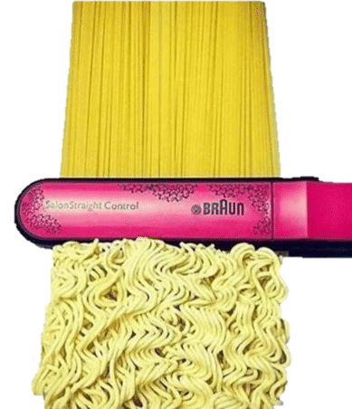


Branch Management
Notes:
How about that branch management strategy
Oh, what strategy?
• branches are organic, we like organic food don’t we?
• Don’t worry, we can get this mess straightened out
• Introducing a conversion from SVN to Git where we can visualize our mistakes

Slide 8
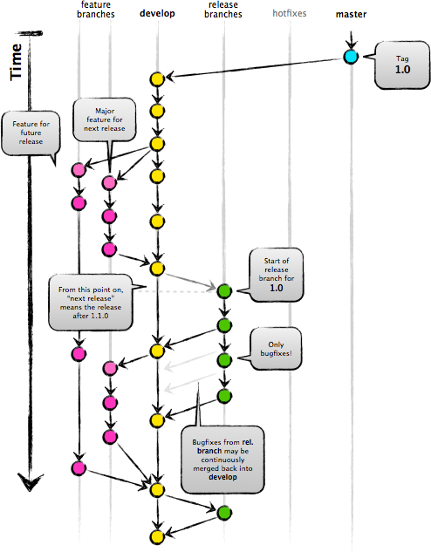
Git-Flow Model
Notes:
How about a model for managing those branches
• No problem with a concept similar to Git-Flow to match our business environment

Slide 9



Hosting?
Notes:
Okay, so we’ve got a good concept for using Git, but how to host it?
• We could always call on our friend from GitHub, Mr. OctoCat
However, our organization basically requires all services to be locally hosted
• Sad OctoCat. Oh, don’t cry little buddy
• Introducing GitLab where you can locally host your repositories

Slide 10
GitLab
Locally Hosted
Simple User Management
Branch Push Protections
HTTP Push Request
Notes:
With GitLab, not only do you get local hosting
• But there is also simple user management
• Branch push protections
• And HTTP push requests supported out of the box

Slide 11



Synchronization
Notes:
How about those pesky workspaces
So, you know how this beautiful snowflake of a system works,
• but your team has no clue what you’ve been doing for months
You definitely don’t want to painstakingly update all of their environments
• That’s okay, you’ve got Docker

Slide 12
Docker
Centralized Workspace Management
Workspace Version Control
Re-Usable Layers (For Build System)
Centralized Distribution
Notes:
With Docker you are able to centralize your workspace management
• There is version control of your environment baked in
• You have re-usable layers for your build system
• And you’ve got a centralized distribution model

Slide 13
A Beautiful Workflow
Notes:
Well, now you’ve established a beautiful workflow
• Where Users write code
• in a Docker
• They leverage CMake to help locally build the code
• You’ve gotten them familiar with Git
• so they can push to your fancy GitLab server
• Which triggers your good buddy Jenkins to build the software
• Who notifies your bug reporting system, and subsequently your developers

Slide 14


Build Warnings
Notes:
But what if you want to do better
Did I hear you want to monitor build warnings?
• In swoops the LLVM dragon with the Clang Compiler
And since it’s never good to put all of your eggs in one basket (no pun intended)
• You lay a GCC egg, and allow a baby bull to be born

Slide 15

Static Analysis
Notes:
Is that static analysis you say?
• Rescued by the LLVM dragon again with Clang-Tidy
• And this time he’s got a sidekick with CPPCheck coming along for the ride

Slide 16


Testing
Notes:
What about testing?
Sure, there are tons of exciting test frameworks to use
• But you are already using Boost libraries in your project
• Ah, heck, why not, Boost_Test to the scene

Slide 17

Code Coverage
Notes:
Too much tooling?, Heck no!
• Analyze your test coverage with Kcov

Slide 18
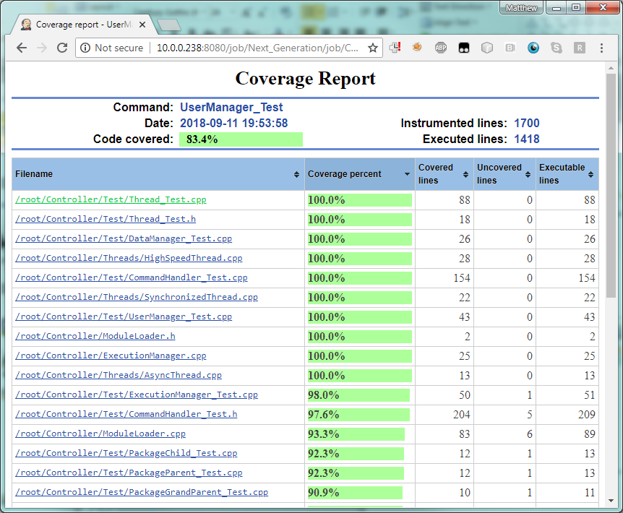
Kcov Reports
Notes:
And get beautiful HTML report outputs!

Slide 19
Sanitizers
Notes:
Hey, you’ve got code that runs, did you know that you can sanitize those tests
• Don’t worry, LLVM has got you covered again
• And you can’t forget about including sanitizers from our buddy baby bull to keep us balanced

Slide 20
Combining it all
Notes:
• Well, you now throw this all together with Jenkins in the middle
• Static Analysis, Compiler Warnings, and Sanitizers from Clang
• Warnings and Sanitizers from GCC
• Static Analysis from CPPCheck
• Unit tests using Boost_Test
• And coverage reports from Kcov
All feeding information to a centralized system

Slide 21
Documentation
Notes:
Oh, and documentation
You didn’t think we’d forget about that, did you?
• Don’t worry, Jenkins can spit that right out for you!

Slide 22
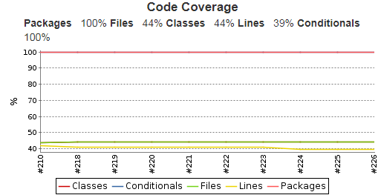
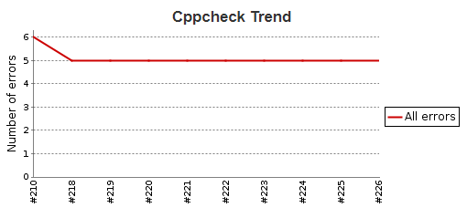
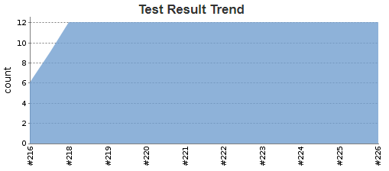
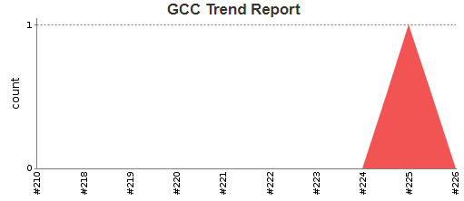
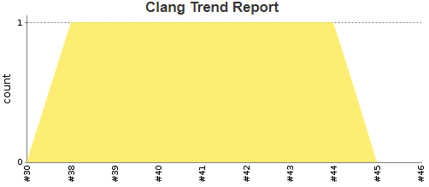
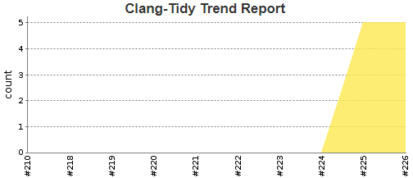
Reports
Notes:
Jenkins, our handy little butler will not only run all of this, but also aggregate the results
• You want CPPCheck trend reports, you got it!
• How about those Clang-Tidy reports?, BAM!
• Feeling like GCC compiler warnings anyone?
• Maybe your flavor is more for Clang warnings instead
• How are your tests running, wait, never mind, I’ve got an awesome summary right here!
• And are we covering all of our bases, sweet, I get a summary EVERY build!

Slide 23







New Development
Notes:
• So, we started with RedMine and
• Cmake
• But then we added Jenkins
• And Git
• And GitLab
• And Docker
• And Kcov
• And CPPCheck
• And Doxygen
• And Boost_Test
• And GCC
• And Clang
• And covered it all with some sanitizers
Well, you shake it all up, and what do you get?
• Jenkins with his GitLab necklace riding a Docker Whale named Doxygen reigning in his pet LLVM dragon all while transporting CPPCheck, GCC, Git, Kcov, Cmake and Boost_Test containers through a Redmine rainbow!

